Slide 1
BMW Sales Analysis (2010–2024)
Krishnapriya E.P
Date:April 2026

Slide 2
Objective
Analyze BMW sales performance (2010–2024)
Identify top-selling BMW models
Compare fuel type performance
Study price vs mileage relationship
Generate insights using Power BI dashboard

Slide 3
Dataset Overview
Source: Kaggle BMW Sales Dataset
Records: 50,000
Time Period: 2010–2024
Key Fields: Model, Year, Region, Sales Volume, Revenue, Price, Mileage, Fuel Type

Slide 4
Business Questions
Which BMW models perform best?
How do sales change over time?
Which regions generate the highest revenue?
Which fuel types dominate sales?
What is the price vs mileage relationship?

Slide 5
Data Processing
Data cleaned using Power Query
Removed missing values
Corrected data types
Created DAX measures
KPIs: Total Sales, Total Revenue, Average Price, Average Mileage

Slide 6
Exploratory Data Analysis
Year-wise sales trend analysis
Model-wise performance comparison
Fuel type distribution analysis
Price vs mileage relationship study

Slide 7
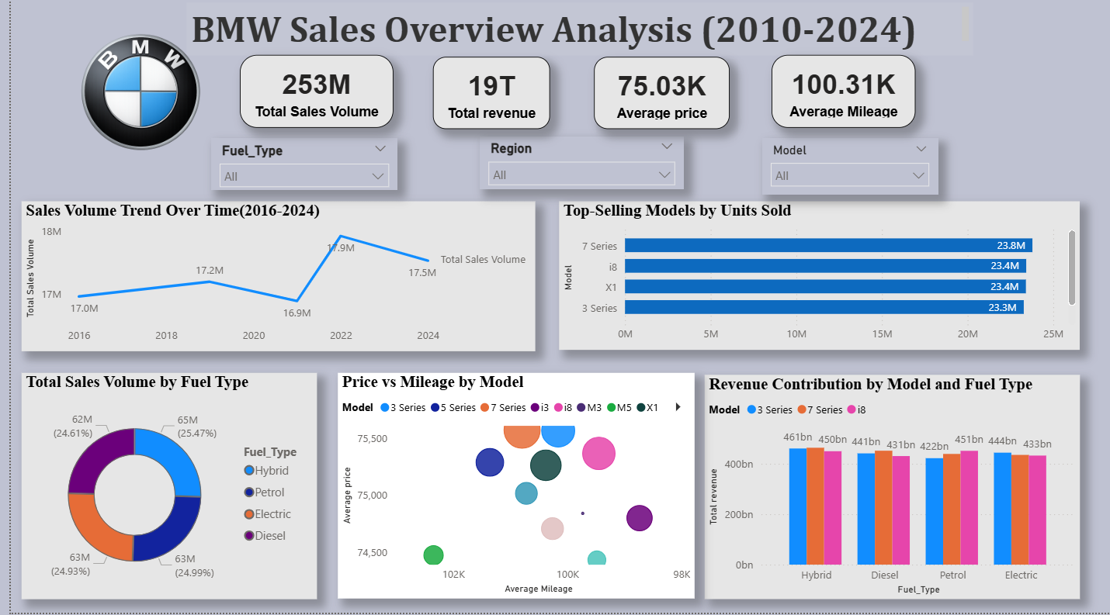
Power BI Dashboard- BMW Sales Overview(2010-2024)

Slide 8
Dashboard Overview
KPI Cards: Sales, Revenue, Avg Price, Avg Mileage
Line Chart: Yearly sales trend
Bar Chart: Top BMW models
Donut Chart: Fuel type contribution
Scatter Plot: Price vs Mileage
Column Chart: Revenue by model

Slide 9
Key Insights
Sales gradually increased over the years
Peak sales observed around 2022–2023
7 Series, i8, X5 contribute major sales
Hybrid and electric vehicles growing
Premium segment demand increasing

Slide 10
Problems Identified
Sales concentrated on limited models
Underperforming regions
Year-wise sales fluctuations
Possible market saturation risk

Slide 11
Recommendations & Conclusion
Promote mid-performing models
Focus on electric and hybrid vehicles
Use region-specific marketing
Apply data-driven pricing strategies
Power BI dashboards support better sales planning

Slide 12
THANK YOU

